Slide 1
Machine Learning Stroke Predictions
Python Machine Learning Bootcamp

Slide 2
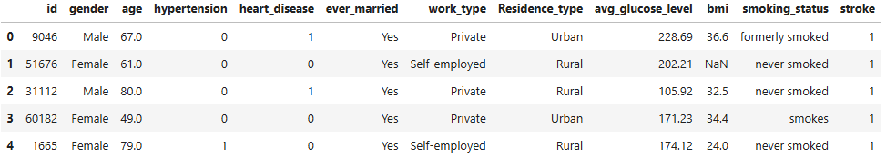
healthcare-dataset-stroke-data

Slide 3
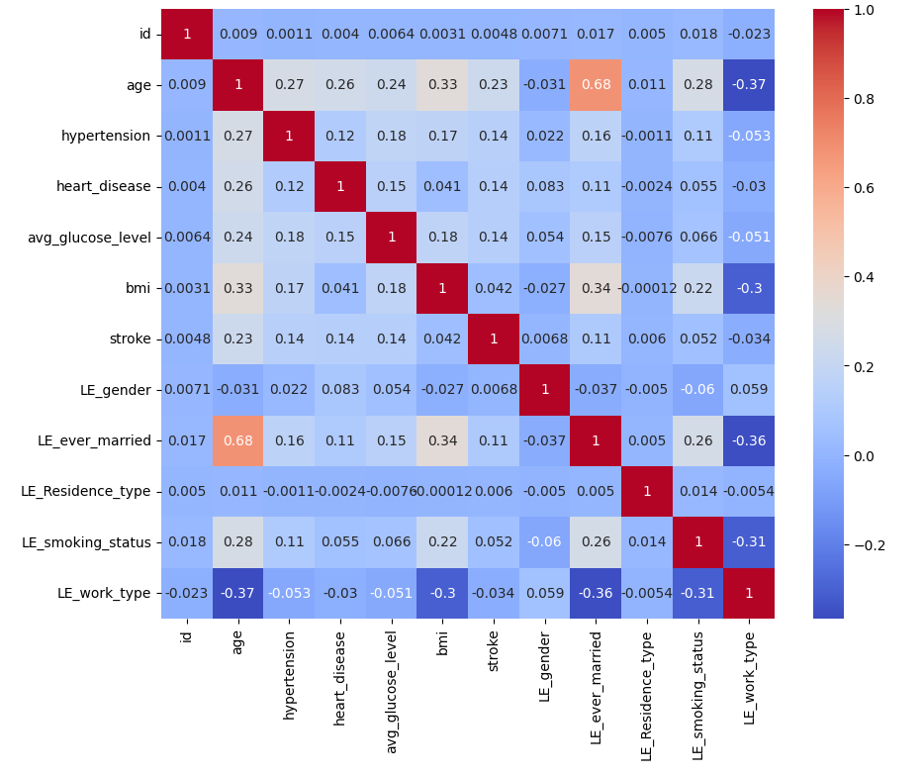
Confusion Adjacency Matrix
Highest correlations:
Age (.23)
Hypertension (.14)
Heart Disease (.14)
Avg Glucose Level (.14)
Ever Married (.11)
Ever Married & Age (.68)

Slide 4

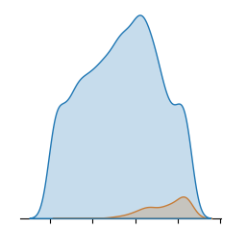
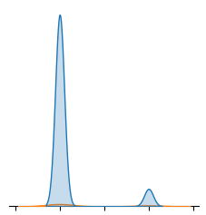
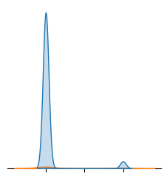
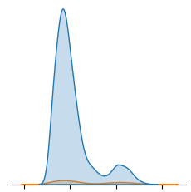
Distribution Plots

Slide 5
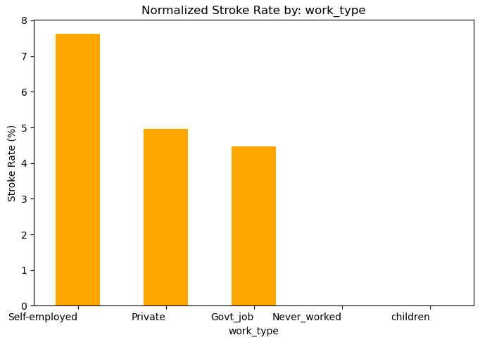
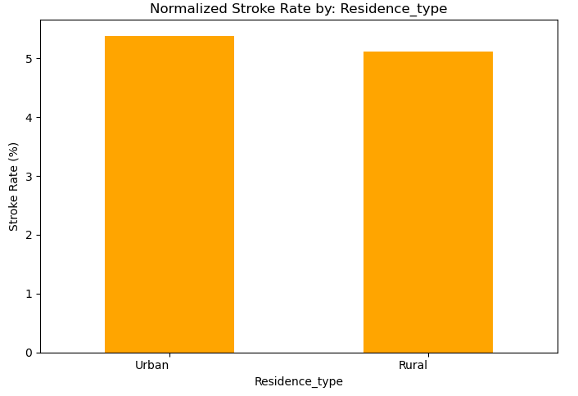
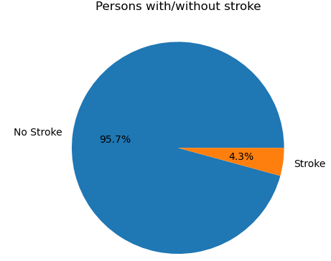
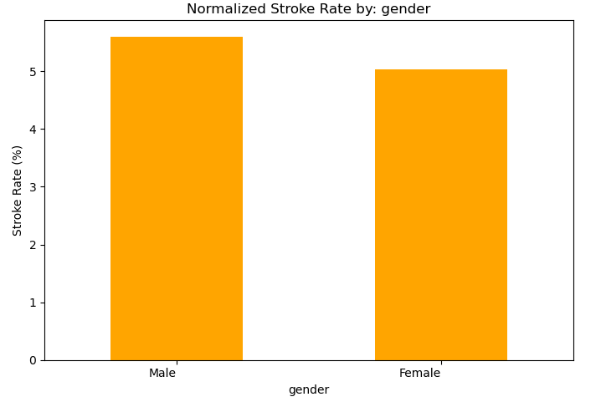
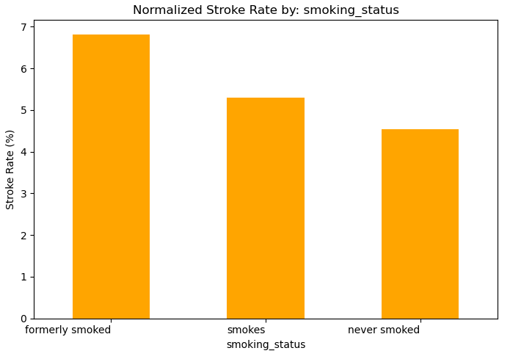
Stroke vs No Stroke

Slide 6
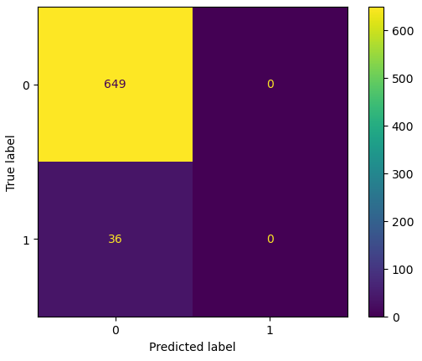
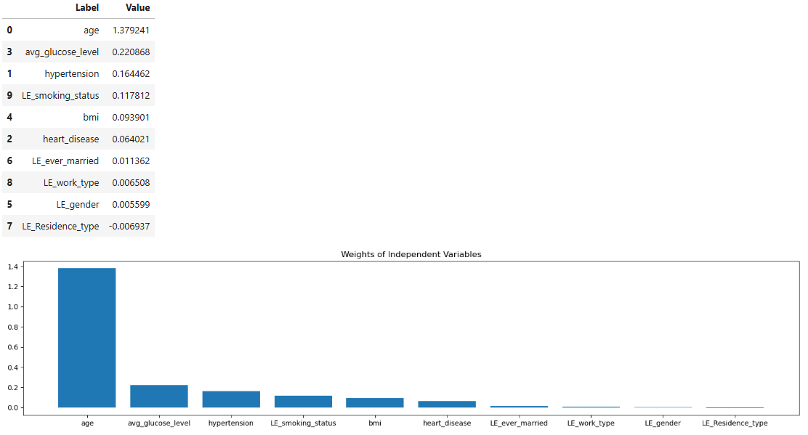
Logistic Regression with Everything & All Samples
This models accuracy = 95 %
Notes:
Model is only 95% accurate because it classifies all as no-stroke
Skewed sample sizes or too many independent variables may cause

Slide 7

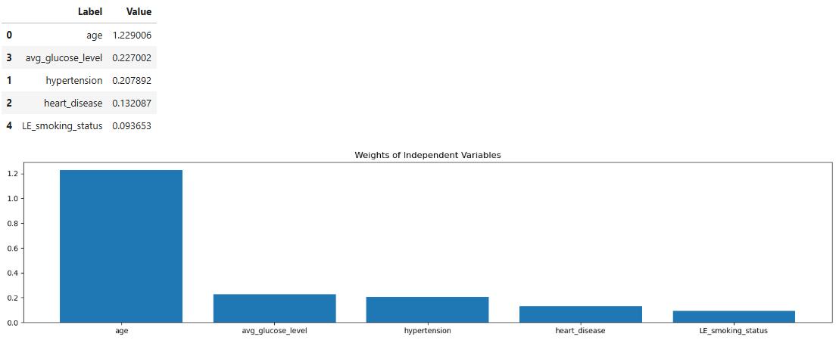
Logistic Regression with [age, glucose, hypertension, heart disease, & smoking status] & All Samples
This models accuracy = 94 %
Notes:
Model is only 94% accurate because it classifies all as no-stroke
Skewed sample sizes is likely the cause

Slide 8
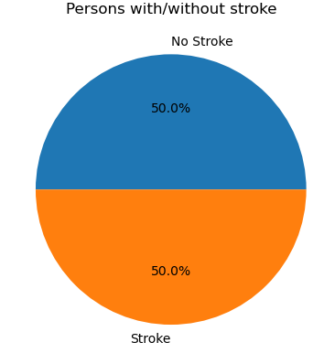
DownSample the Data
#First split the stroke & nonstroke datasets.
true_df = df[df['stroke'] == 1]
false_df = df[df['stroke'] == 0]
fraction=true_df.shape[0]/false_df.shape[0]
# Randomly sample % of the False rows so num of False and True cases are ~
reduced_false_df = false_df.sample(frac=fraction, random_state=42) # use random_state for reproducibility
# Combine the reduced True samples with all False samples
balanced_df = pd.concat([true_df, reduced_false_df]).sample(frac=1)
This code samples the non-stroke data, dependent on the stroke data size.
Making the sample sizes equal.
Count(Stroke)=Count(No Stroke)

Slide 9
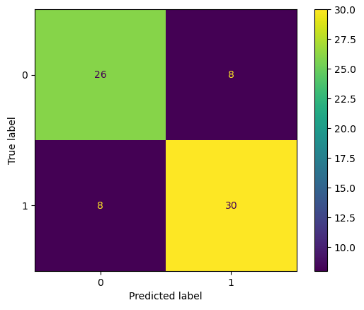
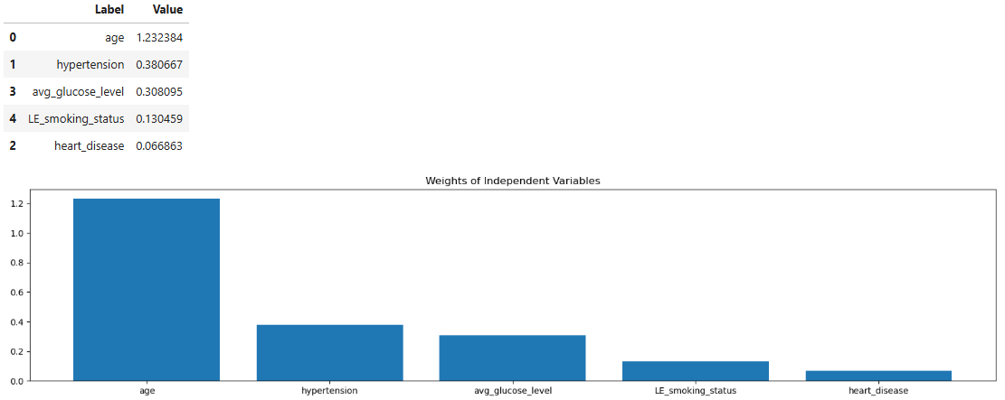
Logistic Regression Downsampled
This models accuracy = 78 %

Slide 10
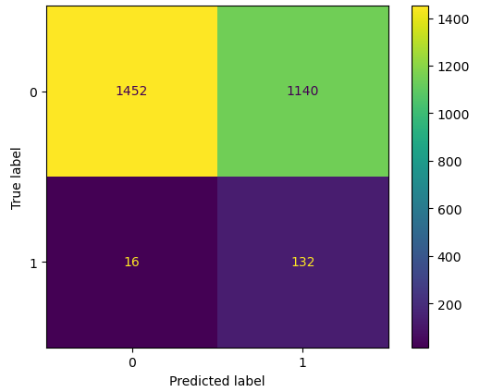
Predicting All
With all Data, this models accuracy = 56 %
Conclusions:
More complex models or more comprehensive datasets are needed for accurate stroke prediction.
Age and Glucose levels are biggest predictors

